Slide 1





Onlline Examination Portall
Submitted by:
Abir Choudhury Asim Ali Harshit Paneri Priyanshu Arora Yash Mali
Yash Soni
(20ETCCS002) (20ETCCS014)
(20ETCCS049) (20ETCCS093) (20ETCCS118) (20ETCCS119)

Slide 2

Problem Statement::
How often do you find yourself using online exam portals for your academic assessments? And how many students are hesitant to even give it a try? Online examination systems, while convenient, face significant challenges that hinder their effectiveness.
Understanding these challenges is crucial in improving the online exam experience. Some of them are:
User Experience: Complexity of User interface, Navigating through multiple menus leads to frustration and inefficiency
Technical Glitches: Occurrence of system crashes, slow loading and submission errors, hence interrupts exam process and also impact students performance and confidence.
Exam Creation and Management: Current process of setting up questions and managing exams params on platforms are cumbersome and time-consuming for instructors.

Slide 3


Our Solution
Our solution aims to provide a seamless experience for student
teachers and organizations for conducting exams online. Let's look into the key features:
Access Code Protection: Each exam is assigned unique access code, ensuring only authorized students can attempt it.
Teacher and Organization Management: Easily create and
manage exams for students, with organizational administrators overseeing teacher and student accounts.
Real-time Exam Monitoring: Restrict students from cheating or switching tabs & accessing unauthorized resources during exam.
Customizable Exam Settings: Teachers can customize exam parameters, including time limits, images, and grading.
Student Dashboard: Students have access to their personalized dashboard, providing an overview of exams and results.

Slide 4





Questions can contain image as well.
User Friendly Web Application
Scope
Exam Management and Management Dashboards
No tab switching is allowed during the exam.
Easy Exam access by exam link and access code
Exams have customizable exam duration and passing criteria.

Slide 5


Easy ayone
Project vision and mission
The primary objective of the Online
Examination Portal is to conduct MCQ-
based examinations online with very little effort.
access to exams,
an exam
01.
can take
anywhere with respect to their organization,
Inclusion of Teacher, Student and Organization, dashboard system. Students can also see there result after exam
.
02.
Its a timer based Exam.For every exam, a timer will be presented and students will be required to complete in that time-frame only.
03.

Slide 6


Ideation process / Working
01
Account Creation: Examiners and student will be required to create separate accounts.
Examiner account will be activated only after approval from admin
02
Creating Exam: Examiners can create exams and need to upload details like questions, their respective options, their correct options, etc.
03
Conducting exam: Exam code will be shared with the student Now they can enter and attempt the exam in the given time frame. Save it and Submit at end.
04
Result View:
Students will be able to view the result just after completing the exam.
Examiners can see which student has scored how much marks.

Slide 7
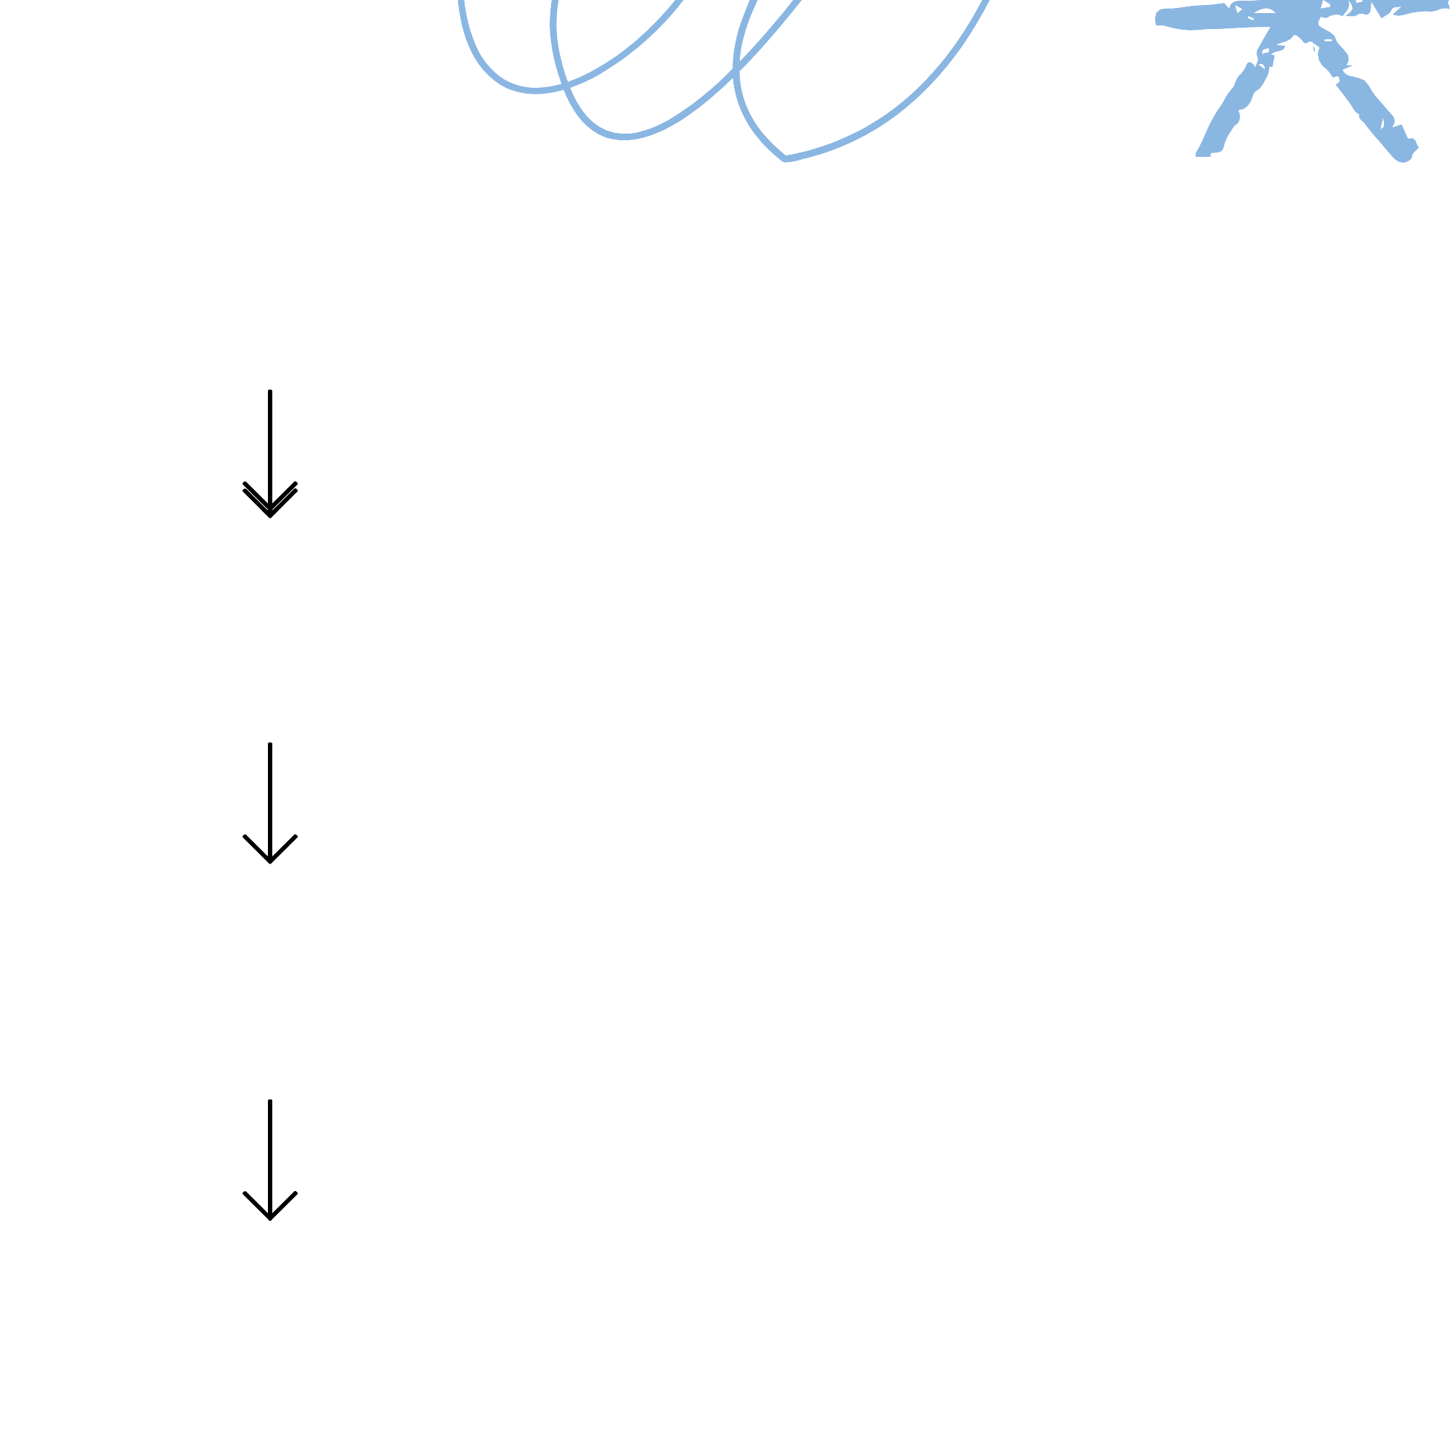

Approve organizations
Key Features
Create/Update Courses
Admin
Approve Teachers
Organization
Create/Update Questions
Upload Question Bank
Teacher
Give exams
Student
View Marks

Slide 8









Tech Stack | Tools
Django
Selenium
HTML/CSS
CI/CD
JavaScript
GitHub/Git
SQLite
Docker
MySQL
Cloud

Slide 9
Do You have Any Questions

Slide 10
Thank you
very much!
onlinexamination.pythonanywhere.com

